Slide 1

Mutual Fund Analytics Project
Advanced Analytics, Risk & Performance Dashboard

Slide 2
PROBLEM & OBJECTIVE
Analyze investor behavior,
Fund performance,
Risk metrics,
Build an interactive dashboard

Slide 3
DATA SOURCES
AMFI Daily NAV TXT
AMFI Historical NAV API
mfapi.in REST API
AMFI Monthly Notes PDF
NSE/BSE Bhavcopy CSV
Pre-packaged CSV datasets provided with this project

Slide 4
ARCHITECTURE
Data Sources
ETL
Analytics Layer
Dashboard & Reporting

Slide 5
EDA HIGHLIGHTS
Investor distribution
SIP trends
Fund allocation patterns
Return distributions
Correlation analysis
Risk exploration

Slide 6
PERFORMANCE METRICS
CAGR
Volatility
Sharpe Ratio
Alpha, Beta
VaR
CVaR,
Rolling Sharpe
Drawdown Analysis

Slide 7
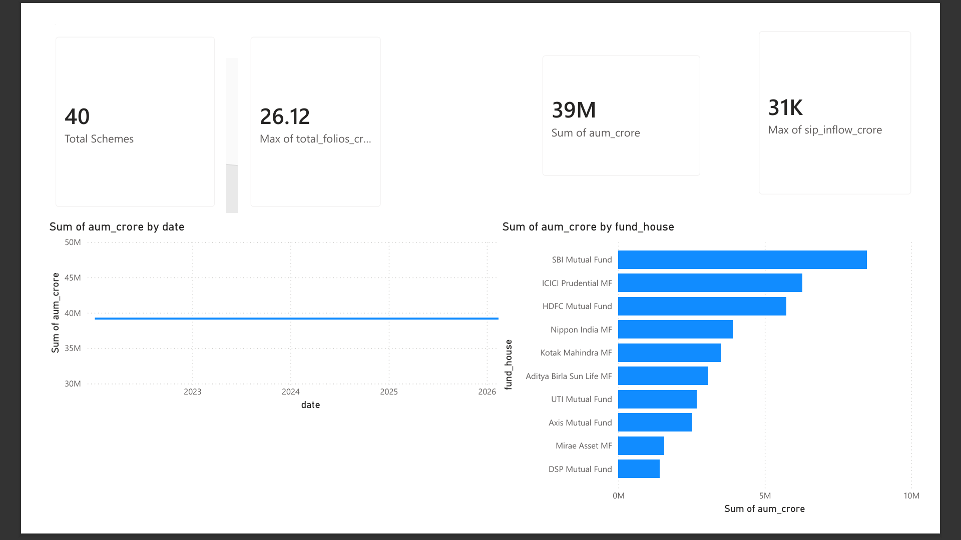
DASHBOARD

Slide 8
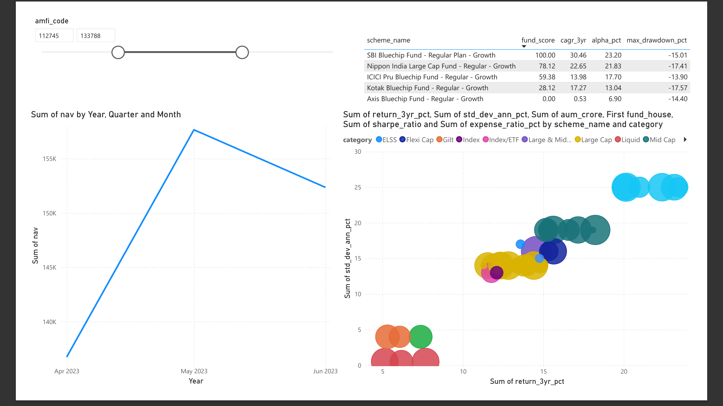

Slide 9
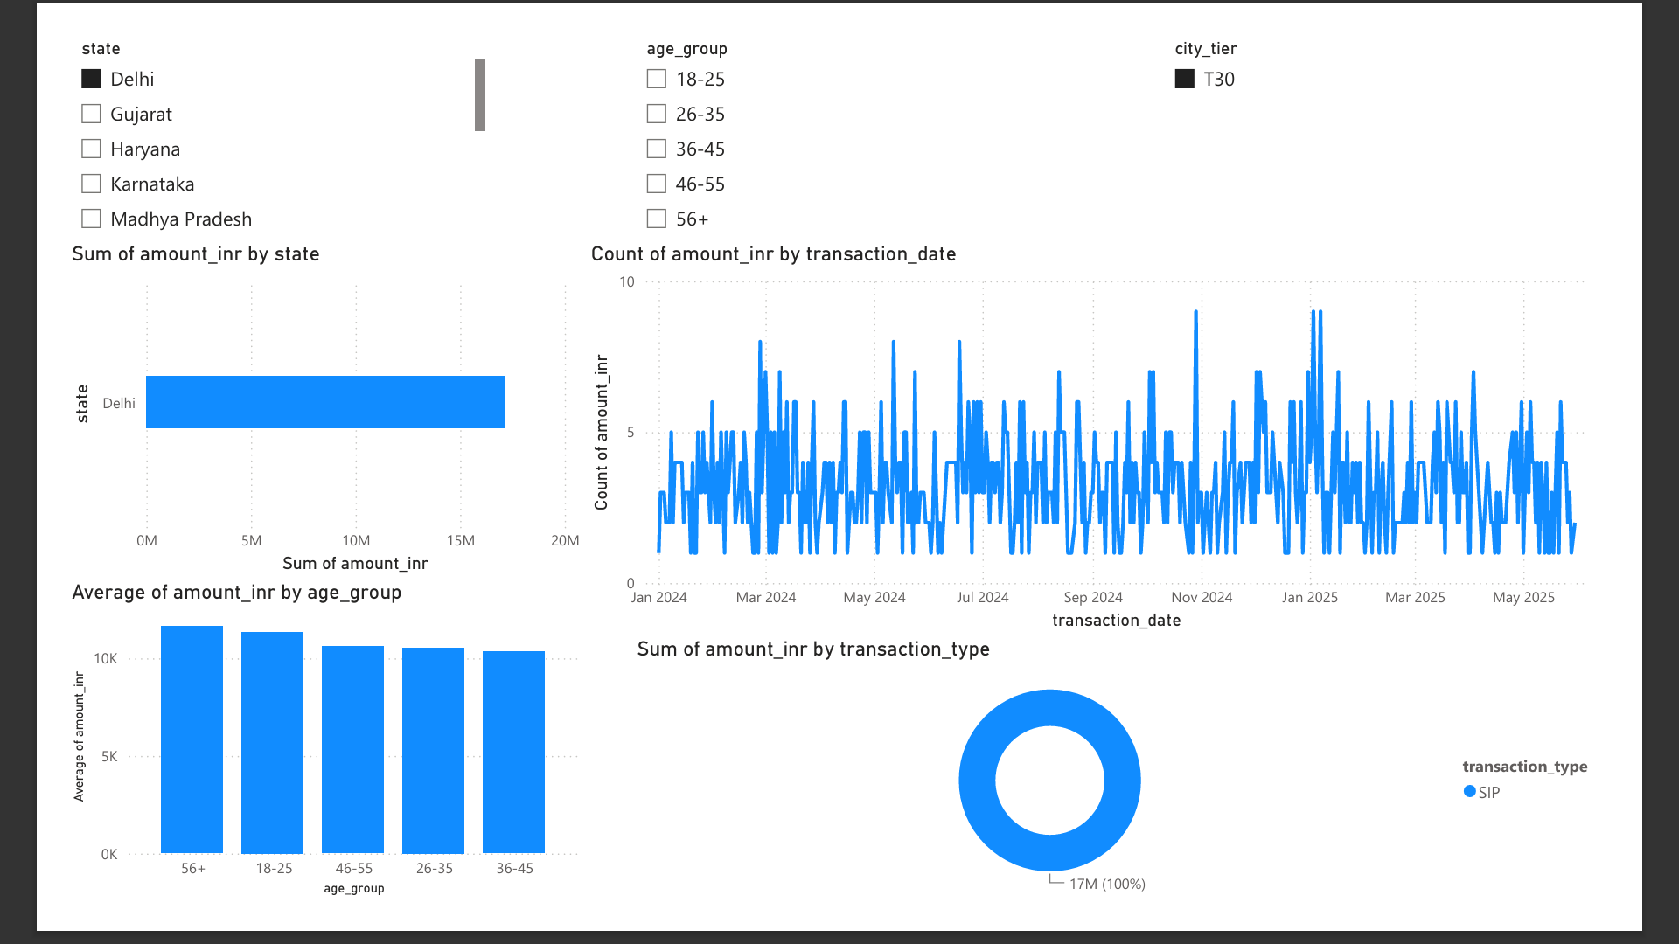

Slide 10
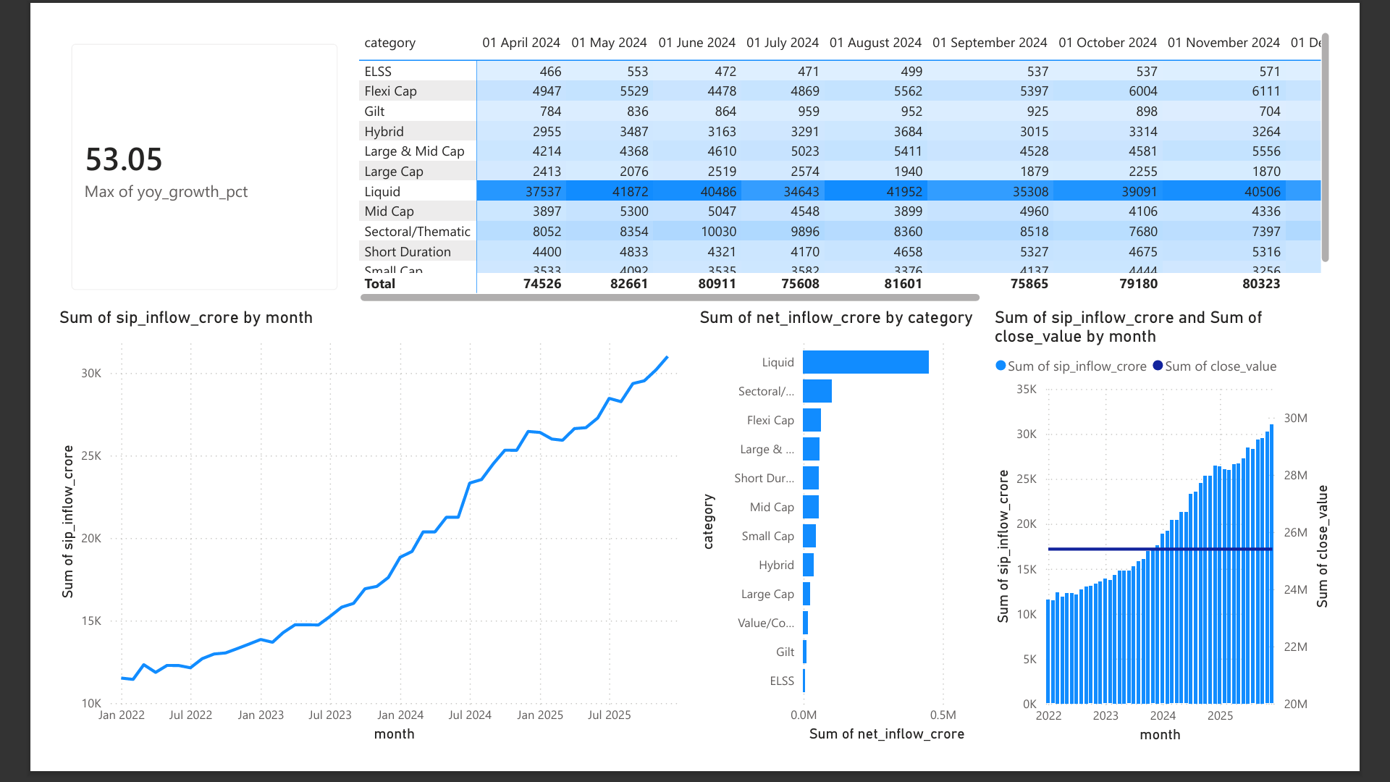

Slide 11
KEY FINDINGS
Top-performing funds
Risk insights
Investor cohort behavior
Recommendations

Slide 12
Thank You
Questions & Discussion

